Slide 1
Software Analytics
Software Analytics in Practice (Talk 2)

Slide 2
Questions from last Talk
Is there any kind of Intelligence attached to software Analytics? Answer: Yes, Software Intelligence: The Future of Mining Software Engineering Data¹
Notes:
Mining software engineering data has emerged as a successful research direction over the past decade. Software Intelligence (SI) as the future of mining software engineering data, within modern software engineering research, practice, and education. We coin the name SI as an inspiration from the Business Intelligence (BI) field, which offers concepts and techniques to improve business decision making by using fact-based support systems

Slide 3
Questions from last Talk…
Why the name of the software analytics products(codemine and stackmine) of Microsoft has the word mine in it ? Do they have any relation with mining data Answer: Yes, they do. We will discuss as we proceed in the presentation.

Slide 4
We’ll be going through one of Microsoft's data analytics product known as stackmine.

Slide 5
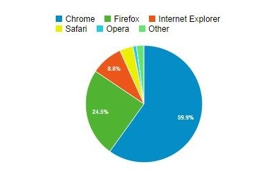
Browsers image: w3schools.com

Slide 6
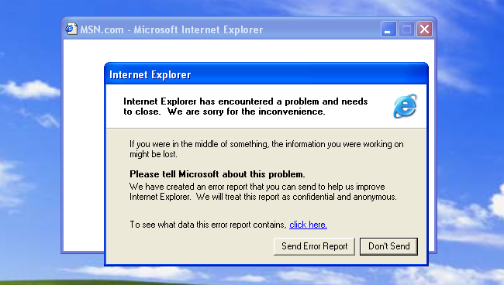
Internet Explorer
I bet every window’s operating system users have experienced it.

Slide 7
Definition
Software Analytics² is to utilize the data-driven approach to enable software practitioners to perform data exploration and analysis in order to obtain insightful and actionable information for completing various tasks around software systems, software users, and software development process.
Notes:
Data driven, elementary maths, insightful and actionable

Slide 8
Paper
Software Analytics in Practice, Dongmei Zhang, Shi Han, Yingnong Dang, Jian-Guang Lou, Haidong Zhang, Microsoft Research Asia, China Tao Xie, University of Illinois at Urbana-Champaign, USA
Published October 2013

Slide 9
Contents
Abstract
Opportunities and challenges
Example Software Analytics Project: StackMine
Lessons Learned on Applying Software Analytics
Conclusion

Slide 10
1. Abstract
StackMine , a successful software analytic project that produced an analytic system used by and transferred to Microsoft product teams.
Lesson learnt, while working on it.

Slide 11
Types of data in software development process
source code
bug reports
check-in histories
test cases, etc.

Slide 12
Plenty of work on predicting software reliability in terms of the defect count at different levels of software systems³.
Utilizing software artifacts to improve the software development process are software intelligence¹ and analytics for software development⁴

Slide 13
Affects & Effect of Internet
Much richer data at much large scale⁵
Its effects(Windows Error Reporting (WER))
Notes:
Windows Error Reporting (WER) (codenamed Watson) is a crash reporting technology introduced by Microsoft with Windows XP. Windows Error Reporting collects and offers to send post-error debug information (a memory dump) using the Internet to the Microsoft or stops responding on a user's desktop. No data is sent without the user's consent

Slide 14
Why Microsoft Software Analytics research group was formed in 2009 ?

Slide 15
Lessons learned during StackMine project
The target problems of software analytics should be what practitioners care about
Domain knowledge is important for correctly understanding the data under analysis
Prototypes should be built early in order to start the feedback loop with practitioners
Scalability and customizability are important when putting software analytics techniques into real use
The results of software analytics need to be evaluated using criteria related to the real tasks that practitioners carry out
Notes:
Difference between researchers and practioners. Importance of Domain Knowledge

Slide 16
2. Opportunities and Challenges
We use Software Analytics to get insightful and actionable information from software artifacts.
For eg, ranked performance bottlenecks represented by sequences of function calls narrow down the investigation scope of the underlying performance issues.
Notes:
Human recognizable pattern? What should be done ?

Slide 17
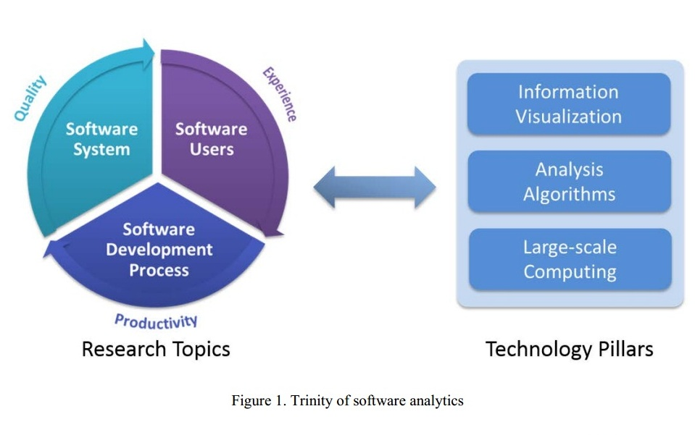
Trinity of Software Analytics

Slide 18
Output of Software Analytics
The output of software analytics projects is usually in the form of insights from software artifacts, i.e., insightful and actionable information, or analytic systems.

Slide 19
3. Example Software Analytics Project: StackMine
StackMine targets at mining large-scale performance traces generated by operating systems.
Notes:
Eg system Hang!!! Ctrl+alt+del, Task manager. Different func calls

Slide 20
3.1Overview
Performance debugging in the large, a recent topic.
Example Microsoft’s Perftrack.
Callstacks is a stack data structure that stores information about the active subroutines of a computer program. This kind of stack is also known as an execution stack, control stack, run-time stack, or machine stack, and is often shortened to just "the stack".

Slide 21
3.2 Identifying essential research problem
Before StackMine was started… windows performance analysis…system even traces…typical research methodology… correlation analysis into a classification and clustering problem.

Slide 22
3.2 Identifying essential research problem…
Form their feedback, team realized that they were not solving the essential problems that they cared about.
missed the most important problem category Wait representing delays due to synchronization, resource contention, and power state, etc.
automatic detection and localization of high CPU-consumption intervals were of little help to solve their real problems.
trace stream was not the right granularity level for similarity modeling and clustering, because it is too high-level to help the performance analysts locate the root causes.

Slide 23
3.3 Understanding the data with domain knowledge
There were 400+ different event types but the team settled with 10+ event types.
Domain knowledge can often help scope the relevant data for study, especially when the data scale is large. The computation was expensive and the result was not satisfactory. To address the issues, the team later designed appropriate ROI-extraction algorithms.
StackMine, uses coverage of performance bottlenecks to measure the effectiveness of identified patterns. Higher coverage would indicate lower probability for high-impact bugs to remain undiscovered.
Notes:
A region of interest (often abbreviated ROI), is a selected subset of samples within a dataset identified for a particular purpose.The concept of an ROI is commonly used in many application areas. In medical terms and computer science terms.

Slide 24
3.4 Building iterative feedback loop
A callstack pattern is a subsequence of function calls shared by a set of callstacks.
The first example is how to define the similarity model for clustering callstack patterns.
The team first used the generic sequence-edit-distance model for clustering since it was a natural choice.
The team used StackMine to help analysts and continuously improved the algorithms at the same time.
Notes:
The research and development of analytics technologies is usually an iterative process, in which getting timely feedback from the target audience is important.

Slide 25
Making Impact
“We believe that the StackMine tool is highly valuable and much more efficient for mass trace streams (100+ trace streams) analysis. For 1000 trace streams, we believe the tool saves us 4-6 weeks of time to create new performance signatures (representations of performance issues), which is quite a significant productivity boost.”

Slide 26
4. Lessons Learned on Applying Software Analytics

Slide 27
4.1 Identifying essential problems
Various types of data are incredibly rich in the software domain, and the scale of data is significantly large.
Notes:
Where to focus?

Slide 28
4.2 Domain semantics should be correctly understood for data preparation
In practice, understanding data is three-fold: data interpretation, data selection, and data filtering. To conduct data interpretation, researchers need to understand basic definitions of domain-specific terminologies and concepts. To conduct data selection, researchers need to understand the connections between the data and the problem being solved. To conduct data filtering, researchers need to understand defects and limitations of existing data to avoid incorrect inference

Slide 29
4.3. A usable system should be built early to enable the feedback loop between researchers and practitioners
It is an iterative process to create software analytics solutions to solve essential problems in practice. Therefore, it is much more effective to build a usable system early on in order to start the feedback loop with the software practitioners.

Slide 30
4.4 Scalability and customization are usually required for analytics solutions
The effectiveness of solution customization in analytics tasks can be summarized as
filtering noisy and irrelevant data,
specifying between data points their intrinsic relationships that cannot be derived from the data itself
providing empirical and heuristic guidance to make the algorithms robust against biased data.

Slide 31
4.5 Evaluation criteria should be tied with real tasks in practice
real tasks
precision
There are two aspects of a typical evaluation of a solution to the target problem
what to evaluate
how to evaluate

Slide 32
5. Conclusion
Solving relevant and specific problems
Using domain knowledge for correct data understanding, building prototypes early to get feedback
Taking scalability and customizability into account
Evaluating analysis results using criteria related to real tasks.

Slide 33
Bibliography
A. E. Hassan and T. Xie. Software Intelligence: Future of Mining Software Engineering Data. In Proc. FSE/SDP FoSER 2010, pages 161 -166, 2010
D. Zhang, Y. Dang, J.-G. Lou, S. Han, H. Zhang, and T. Xie. Software Analytics as a Learning Case in Practice: Approaches and Experiences. In Proc. MALETS 2011, 2011.
Todd L. Graves, Alan F. Karr, J. S. Marron, and Harvey Siy. Predicting Fault Incidence Using Software Change History. IEEE Trans. Softw. Eng. 26, 7, pages 653-661 , 2000.
R. P.L. Buse, T. Zimmermann. Information Needs for Software Development Analytics. In Proc. ICSE 2012 SEIP Track, pages 987-996, 2012.
K. Glerum, K. Kinshumann, S. Greenberg, G. Aul, V. Orgovan , G. Nichols, D. Grant, G. Loihle, G. Hunt. Debugging in the (Very) Large: Ten Years of Implementation and Experience. In Proc. SOSP, pages 103-116, 2009.

Slide 34
Thank You

